Slide 1
Innovating Together: Human-AI Synergy
Sean Wong
2025/08/06

Slide 2
CONTENT
01
AI Everywhere
02
Future of Work
03
Life Re-Engineered
04
Play & Creativity
05
Task Triage
06
Thrive Skills

Slide 3
CONTENT
01
Opportunity Radar
02
Ethics & Next Steps
03
Call to Action

Slide 4
01
AI Everywhere

Slide 5
AI Reshapes Work, Life & Play
01
AI in Work
AI automates routine tasks like data entry, freeing up time for strategic thinking and creativity. It enhances decision-making by providing data-driven insights, making businesses more agile.
02
AI in Life
AI-powered personal assistants manage daily tasks, from scheduling to smart home control. Health and wellness apps use AI to track metrics and offer personalized advice, improving overall well-being.
03
AI in Play
AI transforms gaming with personalized experiences and dynamic content. Creative tools like DALL·E and ChatGPT democratize art and literature, empowering creators to explore new boundaries.

Slide 6
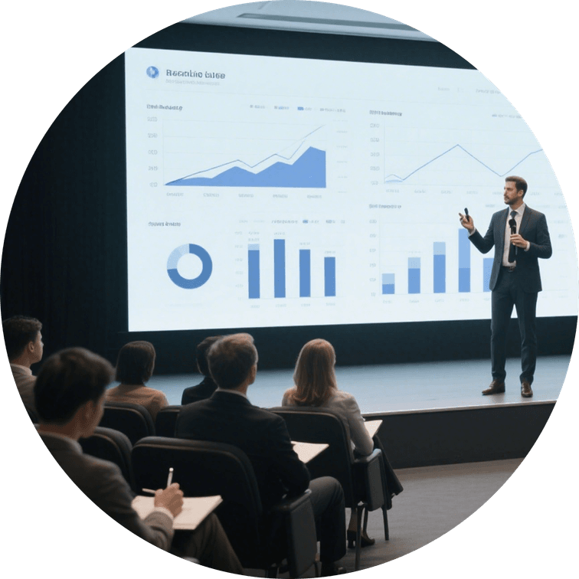

Daily AI Touchpoints You Miss
Invisible Algorithms
Algorithms curate news feeds, predict traffic, and adjust thermostats. These invisible AI touchpoints enhance daily life by reducing friction and expanding choices.
Awareness as First Step
Recognizing these AI interactions is crucial. Awareness allows for intentional collaboration, turning everyday tasks into opportunities for innovation and efficiency.

Slide 7
02
Future of Work

Slide 8
Automation Creates Strategic Space
01
Reclaiming Time
AI absorbs repetitive tasks like data entry and scheduling, freeing up hours for professionals to focus on high-value activities like relationship-building and strategic planning.
02
Enhanced Decision-Making
By providing data-driven insights, AI helps organizations make more informed decisions, leading to increased efficiency and innovation.
03
Strategic Foresight
Professionals can now invest their reclaimed time in forward-thinking initiatives, driving long-term growth and competitive advantage.
04
Purposeful Work
Individuals experience greater job satisfaction as they engage in more meaningful and fulfilling tasks, thanks to AI automation.

Slide 9

Hybrid Roles Emerge Overnight
New Titles and Skills
Roles like AI-augmented marketers and data-anchored project managers are emerging. These hybrid roles demand fluency in AI models and ethical oversight, redefining career paths.

Slide 10
03
Life Re-Engineered

Slide 11


AI Wellness Companions at Home
Health Monitoring
Personalized Wellness
AI-powered wearables track health metrics and offer real-time coaching, enabling preventive healthcare and early intervention.
Voice assistants and chatbots provide tailored wellness advice, from medication reminders to mental health support, enhancing overall well-being.

Slide 12
Adaptive Living
Effortless Convenience
Sustainable Living
Smart homes learn daily routines, adjusting lighting, temperature, and security settings to optimize comfort and energy efficiency.
Automated systems reorder groceries and manage household tasks, reducing manual effort and creating a seamless living experience.
Smart home technology shifts energy usage to off-peak hours, lowering bills and reducing environmental impact.
Smart Homes Anticipate Needs

Slide 13
04
Play & Creativity

Slide 14
AI Ignites Creative Boundaries
Unleashing Creativity
Curatorial Vision
Generative models create original art, music, and stories in seconds, empowering creators to explore new styles and ideas rapidly.
The focus shifts from technical execution to curatorial vision, as AI handles the heavy lifting, allowing creators to refine and direct the creative process.
汇报人：xxx 汇报时间：x年x月x日

Slide 15
Games Adapt to Player Psyche
01
02
03
Part
Part
Part
One
One
One
Dynamic Narratives
Emotional Engagement
Optimized Flow
AI-driven games adapt storylines in real-time, creating personalized experiences that keep players engaged and immersed.
NPCs use voice analysis to respond emotionally, enhancing player connection and making gameplay more responsive to individual psychology.
AI adjusts game difficulty dynamically to maintain the ideal flow state, ensuring players are always challenged but not overwhelmed.

Slide 16
05
Task Triage

Slide 17
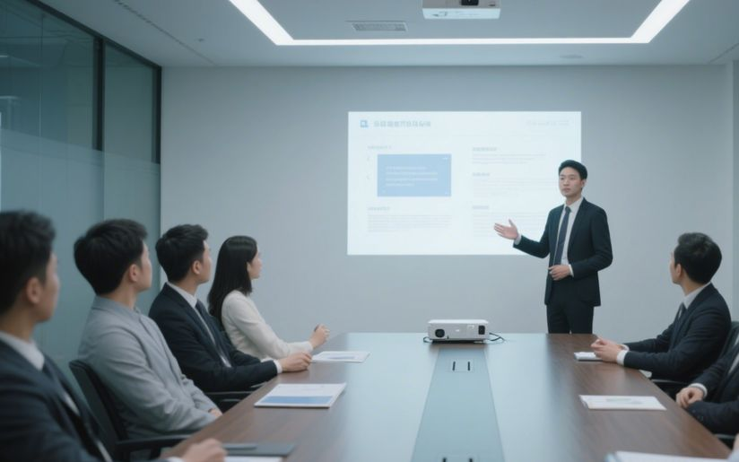
Sort Tasks: Automate, Augment, Lead
Task Mapping
Map tasks on two axes: predictability and need for empathy. High predictability tasks are automated, while those requiring empathy remain human-led, optimizing cognitive load.

Slide 18

AI-Resistant Core Keeps Value
Ethical Judgment
Tasks requiring ethical decision-making remain human-led, as AI cannot fully replicate moral reasoning and societal norms.
Cross-Cultural Negotiation
Empathetic Mentorship
Investing in Human Skills
Human intuition and cultural understanding are crucial in complex negotiations, areas where AI lacks the nuanced context.
Building and maintaining relationships require empathy, a uniquely human trait that AI cannot fully replace.
Focusing on these human-centric skills future-proofs careers and ensures societal trust in critical decision-making processes.

Slide 19
06
Thrive Skills

Slide 20
Five Competencies for AI Synergy
AI Literacy
Understanding AI mechanics is crucial for leveraging technology effectively in both professional and personal contexts.
Critical Thinking
Critical thinking enables humans to frame the right questions and interpret AI insights, ensuring informed decision-making.

Slide 21
Mindset: Collaborator not Competitor
Reframing AI
Growth Mindset
Psychological Pivot
View AI as an amplifier of human potential, not a competitor, to foster a collaborative mindset.
Adopt a growth mindset to embrace continuous learning and adapt to the rapidly evolving AI landscape.
This mindset shift reduces resistance to change and accelerates experimentation, essential for thriving in the AI era.

Slide 22
07
Opportunity Radar

Slide 23

Map Your AI Futures Canvas
Task Inventory
Inventory tasks across work, life, and play, score them on repetition and predictability, and categorize them to visualize change and identify opportunities.

Slide 24
Emerging Roles You Can Claim
01
02
AI Wellness Coach
Ethical Dataset Curator
A role focused on using AI to guide personal health and wellness, combining technology with human empathy.
Ensuring fairness and transparency in AI training data, a critical role in maintaining ethical standards.
03
04
Human-AI Interaction Designer
Augmented Creativity Director
Designing intuitive AI interfaces that enhance collaboration between humans and machines.
Leveraging AI to amplify creative output, blending human vision with algorithmic capabilities.

Slide 25
08
Ethics & Next Steps

Slide 26
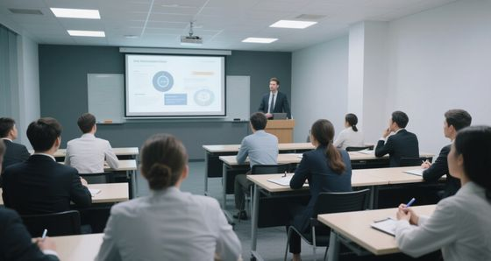

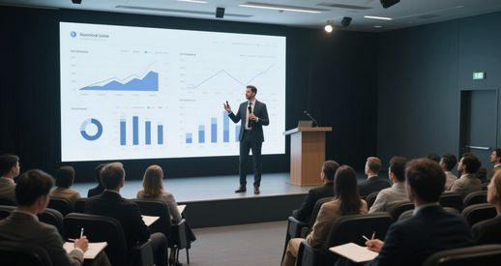
Guard Fairness Transparency Privacy
Bias Audits
Explainability
Privacy Protocols
Conduct regular bias audits to ensure AI systems are fair and unbiased, preventing discriminatory outcomes.
Document model decisions to ensure transparency, building trust and accountability in AI deployments.
Implement differential privacy to protect user data, safeguarding individual information while leveraging collective insights.

Slide 27
Rapid Experimentation Protocol
Micro-Team Pilot
Iterative Learning
Form a small team to pilot an AI solution for a low-risk process, capturing quantitative and qualitative feedback for iteration.
Use rapid cycles to convert uncertainty into empirical insight, building organizational muscle memory for continuous AI integration.

Slide 28
09
Call to Action

Slide 29
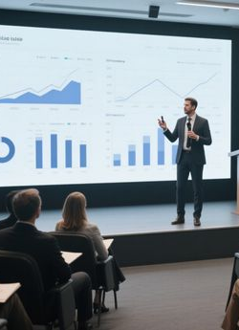
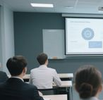
Draft Your 90-Day AI Co-Creator Plan
Action Plan
Choose one personal and one professional process to co-create with AI, set measurable goals, allocate learning time, and schedule a retrospective to ensure progress.

Slide 30
Innovate Together Starting Now
Share Your Map
01
02
Celebrate Micro-Wins
Share your AI Futures Map with peers to gather feedback and iterate, fostering a collaborative environment.
Acknowledge small victories to reinforce a collaborative identity and build momentum for larger initiatives.
Contribute to Community
03
04
Shape the Future
Share lessons learned with open communities to contribute to collective knowledge and shape future AI norms.
By joining the collective experiment today, you can influence how AI amplifies human flourishing tomorrow.

Slide 31
THANK YOU
Sean Wong
2025/08/06

